Slide 1
CONCURRENT ENROLLMENT INSTRUCTOR ESSENTIALS

Slide 2
What We’ll Cover
Intent and Benefits of Concurrent Enrollment Program
RRCC Class Expectations
Course Mirroring or Mapping Requirement
The Rock Portal and Log-in instructions
Roster Reviews
RRCC Grade Posting Instructions and Policies
Desire2Learn (D2L)
First year overview
Notes:
Greetings! We are pleased to welcome you aboard as a Concurrent Enrollment instructor!
This presentation will provide you with a brief overview of everything you’ll need to know as a new RRCC instructor.

Slide 3
The Collective Intent of Concurrent Enrollment
Reduce the need for remediation
Improve high school and college completion rates
Provide equal access to higher education
Reduce the cost of higher education for students
Enrich educational offerings within the high schools
Notes:
In 2009, House Bill 1319 was passed and in 2012 all Colorado Community Colleges began to participate in the Concurrent Enrollment and ASCENT Program.
Concurrent Enrollment Program offers dual credit to high school students in grades 9-12
Through state funding, school district pay the college tuition for the college credits earned through Concurrent Enrollment.
Academic and CTE courses can be offered through Concurrent Enrollment if the courses fit into the student’s ICAP plan.
The intent of the Concurrent Enrollment program is to broaden access to higher education opportunities, increase coordination between secondary and postsecondary and ultimately benefit students.

Slide 4
RRCC Class Expectations
Taught by high school teachers who meet HLC guidelines and approved by RRCC chairs, leads and deans
High school and RRCC curriculum align
Grades permanently recorded on RRCC transcript/GPA is impacted
Annual class observation by RRCC Department chair
Student evaluations collected for each course
Required to post accessible course syllabus in Desire2Learn (D2L) course shells each semester
Notes:
Once qualifications are met and approval is granted, you are considered a RRCC instructor!
The high school curriculum is mapped to meet RRCC/Colorado Community College System (CCCS) course competencies.
Semester classes register each semester (fall in August and/or spring in January). Yearlong classes register just in spring (January).
Concurrent Enrollment courses are not like AP. Attendance, assignments, exams, participation all count towards the final grade and are recorded on the Red Rocks college transcript automatically. They are listed on the transcript as a traditional college course.
Just as with our traditional college courses, class observations by the RRCC Department chair and Student Evaluations (SOI) will be performed close to the end of each semester in order to comply with Higher Learning Commission standards.
Desire2Learn (D2L) is RRCC’s online course component and our version of Schoology. You can use D2L shells to post your course content. RRCC requires that you post your accessible syllabus to D2L. Students can access D2L by logging into “The Rock” portal.

Slide 5
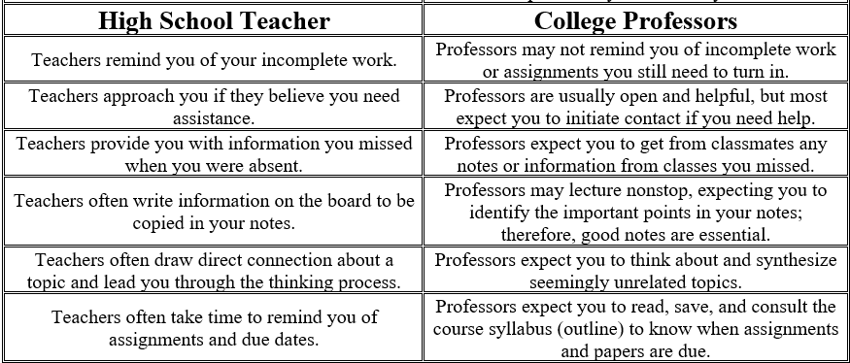
Differences in HS and College Instructor Expectations
Notes:
Source: http://www.slcc.edu/concurrentenrollment/instructors/index.html

Slide 6
Concurrent Enrollment and HLC Accreditation
All courses should mirror those at RRCC or require course mapping to ensure alignment. This can be accomplished by collaborating closely with RRCC department chair/leads.
The Higher Learning Commission (Criterion 3 Standard-Core Component) :
The institution’s program quality and learning goals are consistent across all modes of delivery and all locations (on the main campus, at additional locations, by distance delivery as dual credit, through contractual and consortial arrangements or any other modality) .

Slide 7
RRCC Department Liaison
You will be partnered with an RRCC Liaison in your academic department, which may be the Dean, Chair, or Lead. Your liaison’s contact information is provided on the Instructor Checklist.
Reach out to your liaison to discuss the course, curriculum, syllabi, and department requirements. Course planning can be an intensive process and take a significant amount of time, so we encourage you to connect with your liaison as soon as possible.

Slide 8
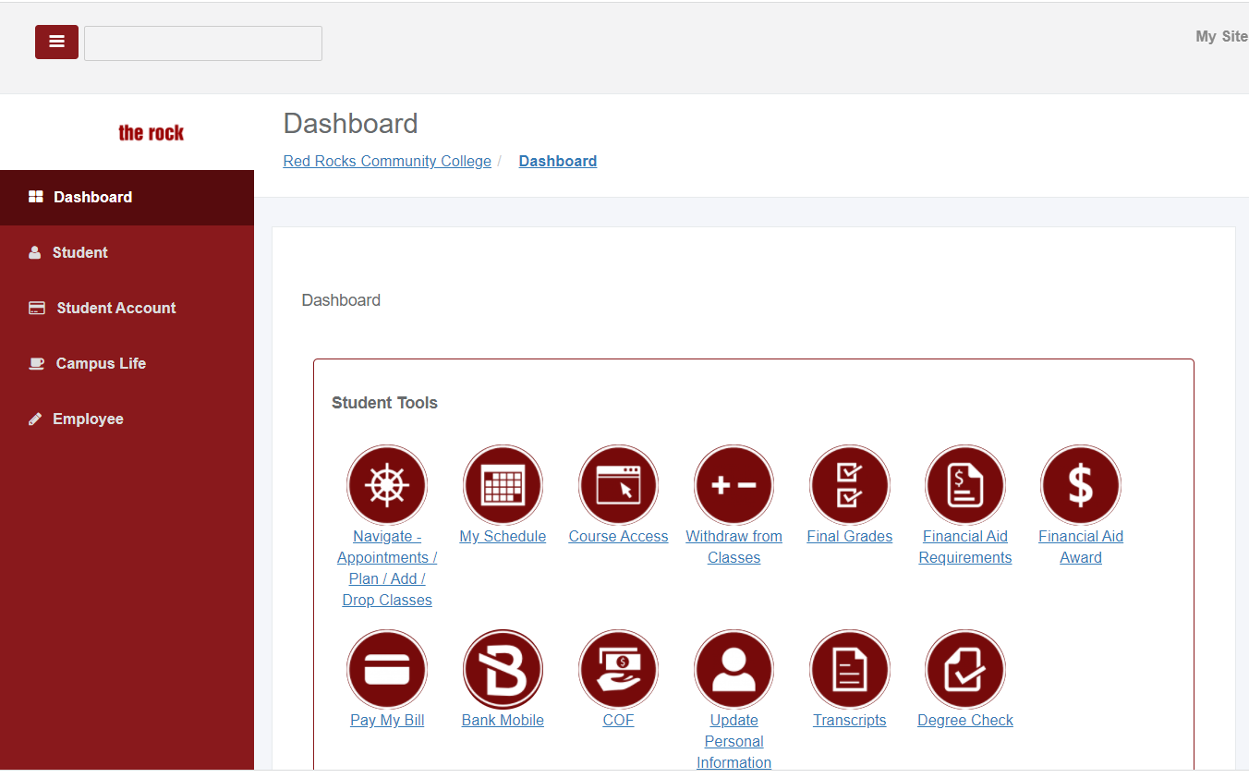
“The Rock” Portal
On the Portal, you can:
Review Rosters
Post Final Grades
Find Concurrent Enrollment Resources & Reports
Request Grade Changes
Access Desire2Learn (D2L)
Notes:
RRCC’s “The Rock” Portal is utilized by students and faculty. It is similar to Parent Portal.
Many faculty tasks take place through “The Rock”, such as reviewing rosters, posting final grades and accessing Desire2Learn. On the Faculty Tab, you will find Concurrent Enrollment resources and materials
On this slide, you will see a screenshot of “The Rock” Dashboard. The Dashboard is a quick way to locate the tasks you will use most.
You can also find the same tasks and additional features on the “Faculty or Instructor Tab”.

Slide 9
Logging into “The Rock” Portal
Go to www.rrcc.edu
Click on
Log in with your RRCC S# and password
Remember to include and capitalize the “S#”
Password Reset Help: 303-914-6677
The Concurrent Enrollment Office can help you locate your “S#” and connect you with IT support if you have log in issues
Notes:
To log into The Rock, you will need your RRCC S# (we can provide you with this number) and your password.
The first time you log in, your default password will be your birthdate in a six digit format. You will then be prompted to set up a security question/answer and to change your password. The you will be provided with password requirements (length and required characters in password).
If you have log-in issues, you can utilize the “forgot Password feature on the log-in screen. You can also call the 24/7 IT help desk.
It’s always a good idea to log-in early and work out any bugs.
Please keep in mind that after several months of inactivity, it’s possible your log-in can expire.

Slide 10
Desire2Learn (D2L)
RRCC’s Learning Management System
Access to course shells
Accessible through “The Rock”
Required to post accessible Syllabus every semester
Desire2Learn (D2L) Presentation- Jon Johnson, Dean of Instructional Technology

Slide 11
Roster Review
Once registration is finalized, you will have the opportunity to review your rosters online on “The Rock” portal.
Please report any students who:
Any students who are no longer enrolled in your class (moved or schedule change)
Any students who are enrolled in your class in error
Notes:
Roster reviews are essential to ensuring your RRCC roster is accurate throughout the semester and during grade posting at the end of the semester.
Roster reviews should be performed after registration is finalized while there is still time to make corrections.
The main purpose is to identify any students who should not be on the roster either because the student is no longer sitting in your class (changed schedule or moved away) or was registered in error by RRCC staff. If you identify students on your roster that should not be there, please notify our office immediately.
Comparing your RRCC roster to your high school roster is also encouraged. This will allow you to document which students did not complete the enrollment process to register and participate in Concurrent Enrollment. This information is helpful if students/parents ask about the college credit in the future.
A second roster review will take place before the college withdraw deadline. During this roster review, we ask that you identify any students who may be at risk of earning a grade below C. Students can be offered the option to withdraw from the course and earn a grade of “W” which will not impact the college GPA.
PLEASE NOTE: We cannot remove students (drop) from your roster or make corrections at the end of the semester when you are posting grades. Corrections can only be made during the initial roster review at the beginning of the semester.

Slide 12
Roster Review Continued
Please note that students who do not appear on your roster may not have completed all the necessary steps to register. You can contact the Concurrent Enrollment Office with any questions about missing students.
Second roster review will be requested before the withdraw deadline to identify any students at risk of earning a D or F.
Corrections can only be made during the initial roster review at the beginning of the semester.
Notes:
Roster reviews are essential to ensuring your RRCC roster is accurate throughout the semester and during grade posting at the end of the semester.
Roster reviews should be performed after registration is finalized while there is still time to make corrections.
The main purpose is to identify any students who should not be on the roster either because the student is no longer sitting in your class (changed schedule or moved away) or was registered in error by RRCC staff. If you identify students on your roster that should not be there, please notify our office immediately.
Comparing your RRCC roster to your high school roster is also encouraged. This will allow you to document which students did not complete the enrollment process to register and participate in Concurrent Enrollment. This information is helpful if students/parents ask about the college credit in the future.
A second roster review will take place before the college withdraw deadline. During this roster review, we ask that you identify any students who may be at risk of earning a grade below C. Students can be offered the option to withdraw from the course and earn a grade of “W” which will not impact the college GPA.
PLEASE NOTE: We cannot remove students (drop) from your roster or make corrections at the end of the semester when you are posting grades. Corrections can only be made during the initial roster review at the beginning of the semester.

Slide 13
Posting RRCC Grades
Grades for all Concurrent Enrollment students must be posted online through “The Rock” portal
Post within 48 hours of last class date
Includes grades below C
Students who are no longer enrolled in your class or move away mid-semester must be reported by Withdraw deadline
Please do not use the “No Shows” option for Concurrent Enrollment students.
Video tutorial
Notes:
At the end of the semester, you will log into “The Rock” student portal to post RRCC grades for your Concurrent Enrollment students. Our office will send you grade posting reminders and provide detailed instructions on how to post grades online at the end of each semester.
With roster reviews done earlier in the semester, you should not have any students on your roster that need to be removed. However if you have a unique situation where a student moved away mid-semester but was not reported to our office, please contact us so we can determine how to resolve the issue, such as by posting a Administrate Withdraw (AW) grade due to an institution error. Later in this presentation, we will discuss unique grading situations.
Grade Posting Deadlines:
The college is aware that the high school calendar is slightly different from the RRCC academic calendar. Therefore, we ask that you just ensure grades are posted before you leave for the semester as part of your “check-out” process.

Slide 14
Important Grade Policies
Course Drops | Before the drop deadline A student will have the option to drop a course. A drop does not appear on the student’s academic record an no tuition is charged. Drops will be made for any students who identified at the time of the roster review.
Course Withdraw | After the drop deadline A student will have the option to withdraw from a course. A withdraw will result in a “W” grade on their transcript that will not impact their college GPA. 100% of the tuition is still charged to the school district. Students are required to submit a withdraw request to initiate a withdraw. Please note: multiple withdraws could impact a student’s college completion rate and future financial aid eligibility. The withdraw option should be considered if the student is at risk of earning a final grade below C.
Notes:
Concurrent Enrollment students must adhere to the same enrollment and grading policies as traditional college students.
Course Drops:
Students will have the ability to drop classes before the drop deadline, which we will publish on the student’s paperwork. However, please note that the drop deadline is very close to the start of the semester. Our office will work closely with you to ensure your rosters are available to review for corrections before our “freeze date”.
Course Withdraw:
Students at risk of earning a D or F will have the option to withdraw before the withdraw deadline, which will be published on the student’s paperwork. We will also send a reminder to review your RRCC roster(s) and identify any students at risk of earning a grade below “C” before the withdraw deadline. Students will be required to submit a withdraw request to our office to process the withdraw.

Slide 15
Important Grade Policies Continued
Incomplete Grades | The “I” grade is a temporary grade that can be issued to a student with an agreement that additional coursework will be completed by an agreed upon deadline. Students must have completed 75% of the coursework with a C or higher. After the grace period, instructors will submit a grade change online to change the “I” grade to a final grade of A-F. An Incomplete Grade Contract must be submitted to the college. RRCC dean approval required.
Grade Changes | In some instances when changes to submitted grades are needed, instructors can submit a Grade Change Form online through “The Rock”. RRCC Dean approval required.
Notes:
Additional grading policies for students in unique situations may be encountered. Below, you will find additional information on some of the unique grading issues:
Grade changes:
If grades were entered incorrectly due to student/instructor assignment submittal errors or if a student submits additional coursework immediately after grades were posted, you can request a grade change online through “The Rock” portal. Grade changes are reviewed by the college dean and forwarded to Student Records if approved.
If you have a student with an verifiable extenuating circumstance (illness, injury, etc.) that prevented the student from completing coursework to pass the course successfully, the following options can be considered:
Incompletes Grades:
If a student is not able to complete the learning objectives before the end of a course because of verifiable extenuating circumstances, the instructor may request a grade of Incomplete. The student must have completed 75% of the coursework with a C or higher. Before the end of the semester, the student and instructor will make arrangements to complete a Incomplete Grade Contract (found on “The Rock”). If coursework is not completed by agreed-upon deadline, a final grade will be posted based on work completed.
Administrative Withdraws:
For students with a verifiable extenuating circumstance that cannot complete coursework, an Administrative Withdraw can be considered with dean approval.

Slide 16
Important Grade Policies Continued
Administrative Withdraws | In rare occasions, an Administrative Withdraw can be requested by the instructor on a student’s behalf. An “AW” is for students who have encountered extenuating circumstances that prevented the student from completing coursework, such as illness or injury. Consult with the Concurrent Enrollment Office. RRCC Enrollment Services approval required.
Notes:
Additional grading policies for students in unique situations may be encountered. Below, you will find additional information on some of the unique grading issues:
Grade changes:
If grades were entered incorrectly due to student/instructor assignment submittal errors or if a student submits additional coursework immediately after grades were posted, you can request a grade change online through “The Rock” portal. Grade changes are reviewed by the college dean and forwarded to Student Records if approved.
If you have a student with an verifiable extenuating circumstance (illness, injury, etc.) that prevented the student from completing coursework to pass the course successfully, the following options can be considered:
Incompletes Grades:
If a student is not able to complete the learning objectives before the end of a course because of verifiable extenuating circumstances, the instructor may request a grade of Incomplete. The student must have completed 75% of the coursework with a C or higher. Before the end of the semester, the student and instructor will make arrangements to complete a Incomplete Grade Contract (found on “The Rock”). If coursework is not completed by agreed-upon deadline, a final grade will be posted based on work completed.
Administrative Withdraws:
For students with a verifiable extenuating circumstance that cannot complete coursework, an Administrative Withdraw can be considered with dean approval.

Slide 17
First Year Overview
One semester prior to teaching
Schedule a meeting with your RRCC CE liaison.
Course syllabus and curriculum must be approved before May 1 (fall courses) or Dec 1 (new spring courses).
Log into the Rock and become familiar with the RRCC system. Your D2L shell will be available prior to the start date of the class.

Slide 18
First Year Overview
One semester prior to teaching
The following must be approved and aligned with on-campus courses prior to offering the course:
Class has been reviewed and matches a Common Course in CCCNS and RRCC’s catalog.
Course syllabus has been reviewed.
Course assignments, tests, and papers are at the same level, rigor, relevance, and depth as those in campus-based courses.
Textbook and course materials have been reviewed and are appropriate for use in teaching the college course.
The instructional facilities, including laboratory, studio, and technology facilities have been reviewed and are comparable to campus-based facilities

Slide 19
First Year Overview
One semester prior to teaching
Ensure all textbooks and course materials have been purchased; if using OER materials, ask department about D2L course shells and student access options
CTE Instructors:
Complete any additional requested CTE paperwork to receive post-secondary CTE credential.
Send official transcripts to CTE.credentials@rrcc.edu

Slide 20
First Year Overview
One month prior to teaching
Attend new instructor orientation at RRCC (optional, but encouraged)
If using D2L for instruction, notify your district CE office and the RRCC CE office to prioritize registration
Upload syllabus to D2L course shell and email a copy to highschoolrelations@rrcc.edu
Communicate with liaison for any updates
Check email for information on student registration

Slide 21
First Year Overview
First week
Start teaching!
Distribute RRCC syllabus to students and ensure they are familiar with the differences in HS and college syllabi, and expectations of a college student.
Work with district and RRCC CE office to coordinate and support student registration.

Slide 22
First Year Overview
Throughout the semester
Check roster on The Rock once registration in complete and inform district and RRCC office of any errors.
Schedule yearly observation with RRCC CE liaison.
Alert CE office of any students at risk of a D or F that will need to be withdrawn from the course with a grade of W.
Communicate regularly with department liaison for information on department/advisory meetings.

Slide 23
First Year Overview
End of semester
Have students complete Student Observations of Instruction (SOIs) through D2L, or a link provided by the RRCC CE office.
Submit final grades in Banner.
Submit any additional requested course materials to your department (e.g. common final exams, grade reports). This may vary by department.

Slide 24
First Year Overview
Prep for the following year
Attend annual professional development at RRCC.
Submit updated syllabus and any changes in curriculum to department liaison.
Submit request form to add a new course in the same discipline by March 15.
Receive appointment letter for next academic year in May.

